Slide 1
CS 235 Nearest Neighbor Classification
Dear Students, please complete the exercises in this document.
They will not be graded or collected, but follow-ups assignments that expand on this example will be.
We are going to do Nearest Neighbor Classification.
Important note: Matlab has (a very nice) built in Nearest Neighbor Classification tool, but we are not going to use it!
I want us to see more explicitly what is happening, and we are going to need to modify our code later.
To be clear, I have run a bunch of examples below, but I expect you to start by re-running the code yourself to confirm all my results.
All the file you need are here: http://www.cs.ucr.edu/~eamonn/CS235/

Slide 2
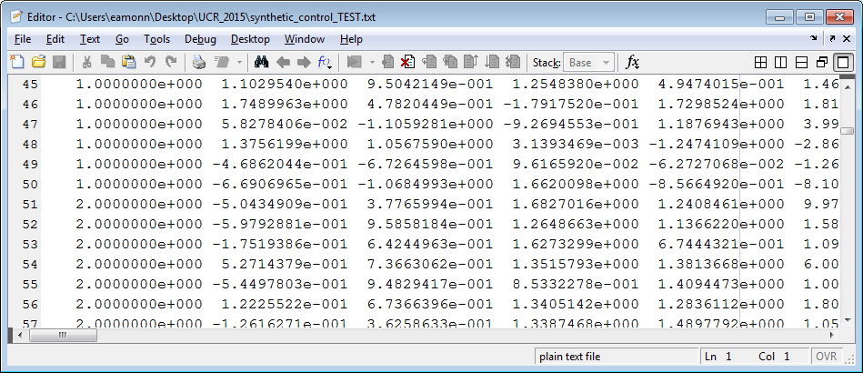
CS 235 Nearest Neighbor Classification: Warm up
We are going to use a standard data format, used by 95% of the datasets out there.
The class labels will be distinct integers starting at ‘1’. So, for example ‘1’ might be spam, ‘2’ might be work-emails etc.
The class labels will be in the first column (this is inconsistent with some examples in my slides).
The rest of the columns are the features.
This instance is in class 1
This instance is in class 2

Slide 3
Data Format
Each of the datasets comes in two parts, a TRAIN partition and a TEST partition.
For example, for the synthetic control dataset we have two files, synthetic_control_TEST and synthetic_control_TRAIN
The two files will be in the same format, but are generally of different sizes.
The files are in the standard ASCII format that can be read directly by most tools/languages.
For example, to read the two synthetic control dataset s into Matlab, we can type…
>> TRAIN = load('synthetic_control_TRAIN'); >> TEST = load('synthetic_control_TEST' );
…at the command line.
There is one data instance per row. The first value in the row is the class label (an integer between 1 and the number of classes). The rest of the row are the data values, and individual time series.
This instance is in class 1
This instance is in class 2

Slide 4
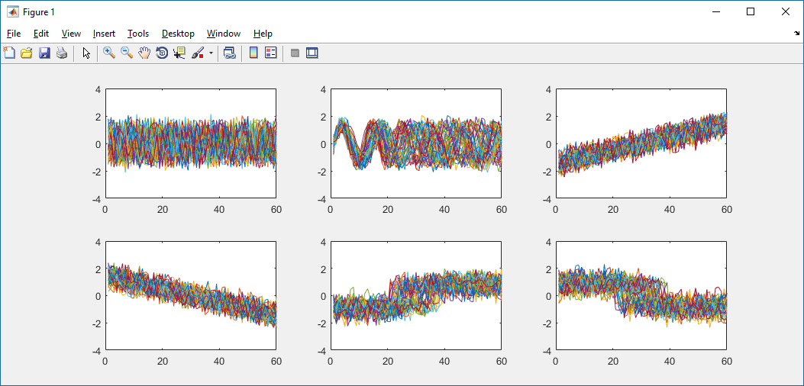
What is the data we are going to classify? In a sense, it does not matter, at least for the code we have to write.
However, they are time series objects. Think of heartbeats, or 60 days of the value of your stocks, etc
In this case, the time series classes correspond to 6 different situations that can occur during an hour of manufacturing some auto parts. For example, class 3 corresponds to a steady increasing of temperature, but class 2 corresponds to an oscillating temperature (with each item having a slightly different period) etc.
It is always a good idea to plot some data as a sanity check, as I have done.
TRAIN = load('synthetic_control_TRAIN');
subplot(2,3,1)
for i = 1: 300
if TRAIN(i,1) == 1
subplot(2,3,1);, plot(TRAIN(i,2:end));, hold on;
elseif TRAIN(i,1) == 2
subplot(2,3,2);, plot(TRAIN(i,2:end));, hold on;
elseif TRAIN(i,1) == 3
subplot(2,3,3);, plot(TRAIN(i,2:end));, hold on;
elseif TRAIN(i,1) == 4
subplot(2,3,4);, plot(TRAIN(i,2:end));, hold on;
elseif TRAIN(i,1) == 5
subplot(2,3,5);, plot(TRAIN(i,2:end));, hold on;
elseif TRAIN(i,1) == 6
subplot(2,3,6);, plot(TRAIN(i,2:end));, hold on;
end
end

Slide 5
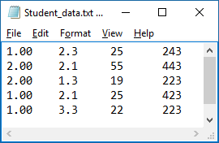
Minor point
For many datasets, you could swap the feature columns, and it would make no difference.
For example, if we have {GPA, AGE, SAT}, it would make no difference if we rearranged them to {AGE, SAT, GPA}.
But for time series, the columns are arranged in a meaningful order, we cannot permute them.
{GPA, AGE, SAT}

Slide 6
What is the default error-rate for this problem?
>> [class count] = mode(TRAIN(:,1));
>> 1-count/size(TRAIN(:,1),1)
ans =
0.8333
The default error rate is 0.8333 or 83.33%
Which means….
The default accuracy rate is 0.1667 or 16.67%
(do you understand why the code above is computing the default error rate?)

Slide 7
1NN Classification
function UCR_time_series_test %%%%%%%%%%%%%%%%%%%%%%%%%%%%%%%% (C) Eamonn Keogh %%%%%%%%%%%%%%%%%%%%%%%%%%%%%%%%% TRAIN = load('synthetic_control_TRAIN'); % Only these two lines need to be changed to test a different dataset. % TEST = load('synthetic_control_TEST' ); % Only these two lines need to be changed to test a different dataset. % %%%%%%%%%%%%%%%%%%%%%%%%%%%%%%%%%%%%%%%%%%%%%%%%%%%%%%%%%%%%%%%%%%%%%%%%%%%%%%%%%%%%%%%%%%%%%%%%%%%%%%%%%%%%%%%%% TRAIN_class_labels = TRAIN(:,1); % Pull out the class labels. TRAIN(:,1) = []; % Remove class labels from training set. TEST_class_labels = TEST(:,1); % Pull out the class labels. TEST(:,1) = []; % Remove class labels from testing set.
correct = 0; % Initialize the number we got correct
for i = 1 : length(TEST_class_labels) % Loop over every instance in the test set classify_this_object = TEST(i,:); this_objects_actual_class = TEST_class_labels(i); predicted_class = Classification_Algorithm(TRAIN,TRAIN_class_labels, classify_this_object); if predicted_class == this_objects_actual_class correct = correct + 1; % we got one more correct end; disp([int2str(i), ' out of ', int2str(length(TEST_class_labels)), ' done']) % Report progress end;
%%%%%%%%%%%%%%%%% Create Report %%%%%%%%%%%%%%%%%%%%%%%%%%%%%%%%%%%%%%%%%%%%%%%%%%%%%%%%%%%%%%%%%%%%%%%%%%%%%%%%%%%%%%%%% disp(['The dataset you tested has ', int2str(length(unique(TRAIN_class_labels))), ' classes']) disp(['The training set is of size ', int2str(size(TRAIN,1)),', and the test set is of size ',int2str(size(TEST,1)),'.']) disp(['The time series are of length ', int2str(size(TRAIN,2))]) disp(['The error rate was ',num2str((length(TEST_class_labels)-correct )/length(TEST_class_labels))]) %%%%%%%%%%%%%%%%% End Report %%%%%%%%%%%%%%%%%%%%%%%%%%%%%%%%%%%%%%%%%%%%%%%%%%%%%%%%%%%%%%%%%%%%%%%%%%%%%%%%%%%%%%%%%%%% %%%%%%%%%%%%%%%%%%%%%%%%%%%%%%%%%%%%%%%%%%%%%%%%%%%%%%%%%%%%%%%%%%%%%%%%%%%%%%%%%%%%%%%%%%%%%%%%%%%%%%%%%%%% % Here is a sample classification algorithm, it is the simple (yet very competitive) one-nearest % neighbor using the Euclidean distance. %%%%%%%%%%%%%%%%%%%%%%%%%%%%%%%%%%%%%%%%%%%%%%%%%%%%%%%%%%%%%%%%%%%%%%%%%%%%%%%%%%%%%%%%%%%%%%%%%%%%%%%%%%%% function predicted_class = Classification_Algorithm(TRAIN,TRAIN_class_labels,unknown_object) best_so_far = inf; for i = 1 : length(TRAIN_class_labels) compare_to_this_object = TRAIN(i,:); distance = sqrt(sum((compare_to_this_object - unknown_object).^2)); % Euclidean distance
if distance < best_so_far predicted_class = TRAIN_class_labels(i); best_so_far = distance; end end;
You should run this simple piece of matlab code.
We will go over this in class, but… You need to understand this code! You will be modifying it extensively.
>> UCR_time_series_test
1 out of 300 done 2 out of 300 done … 299 out of 300 done 300 out of 300 done The dataset you tested has 6 classes The training set is of size 300, and the test set is of size 300. The time series are of length 60 The error rate was 0.12

Slide 8
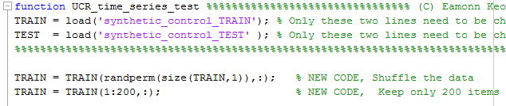
>> UCR_time_series_test
1 out of 300 done … 300 out of 300 done The dataset you tested has 6 classes The training set is of size 300, and the test set is of size 300. The time series are of length 60 The error rate was 0.12
Our training set had 300 items, and we got an error rate of 0.12
What would happen if we had a smaller training set?
To see, we just need to add two new lines of code. We first shuffle the data, then we keep only the first 200 datapoints.
Add 2 lines
Our training set now has 200 items, and our error rate went up to 0.136
You might get a little different results, because of the random shuffle (run the code a few times….
>> UCR_time_series_test
1 out of 300 done … 300 out of 300 done The dataset you tested has 6 classes The training set is of size 200, and the test set is of size 300. The time series are of length 60 The error rate was 0.136

Slide 9
As shown below, lets try an even smaller dataset, only 20% of the original size.
You should run the code ten times, to get a feel for the variability (recall, each run is a random subset of the full training data)
Our training set now has 60 items, and our error rate went up to 0.23667
You might get a little different results, because of the random shuffle (run the code a few times….
>> UCR_time_series_test
1 out of 300 done … 300 out of 300 done The dataset you tested has 6 classes The training set is of size 60, and the test set is of size 300. The time series are of length 60 The error rate was 0.23667

Slide 10
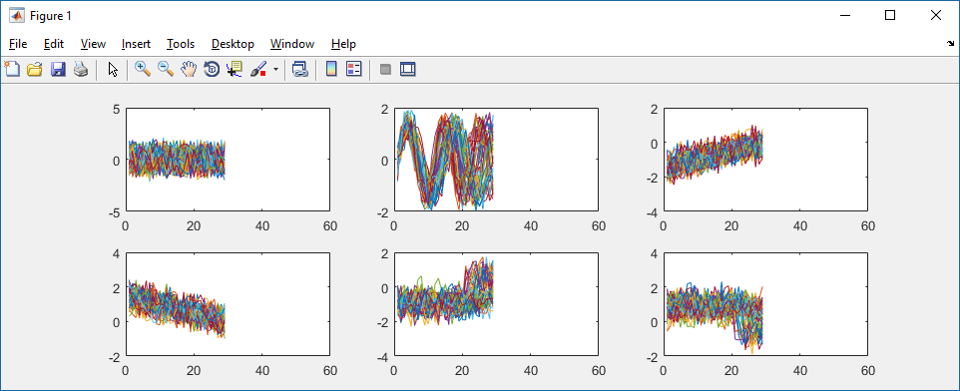
(return to the default code I gave you)
We have a full hour of data for each object. What would happen if we only had the first 30 minutes?
We can find out by adding these two lines of code to lines 4 and 5 of the code I gave you.
TRAIN(:,32:end) =[];
TEST(:,32:end) =[];
To see what difference it makes to the error-rate, see next slide.
Old (full original)
New (truncated)

Slide 11
>> UCR_time_series_test
1 out of 300 done … 300 out of 300 done The dataset you tested has 6 classes The training set is of size 300, and the test set is of size 300. The time series are of length 60 The error rate was 0.12
We went from this error rate with 60 minutes
.. to this error rate with only 30 minutes
Let’s cut out more data, and look only at the first ten minutes!
The error rate
is now much higher.
TRAIN(:,12:end) =[];
TEST(:,12:end) =[];
>> UCR_time_series_test
1 out of 300 done … 300 out of 300 done The dataset you tested has 6 classes The training set is of size 300, and the test set is of size 300. The time series are of length 30 The error rate was 0.1433
>> UCR_time_series_test
1 out of 300 done … 300 out of 300 done The dataset you tested has 6 classes The training set is of size 300, and the test set is of size 300. The time series are of length 10 The error rate was 0.2533

Slide 12

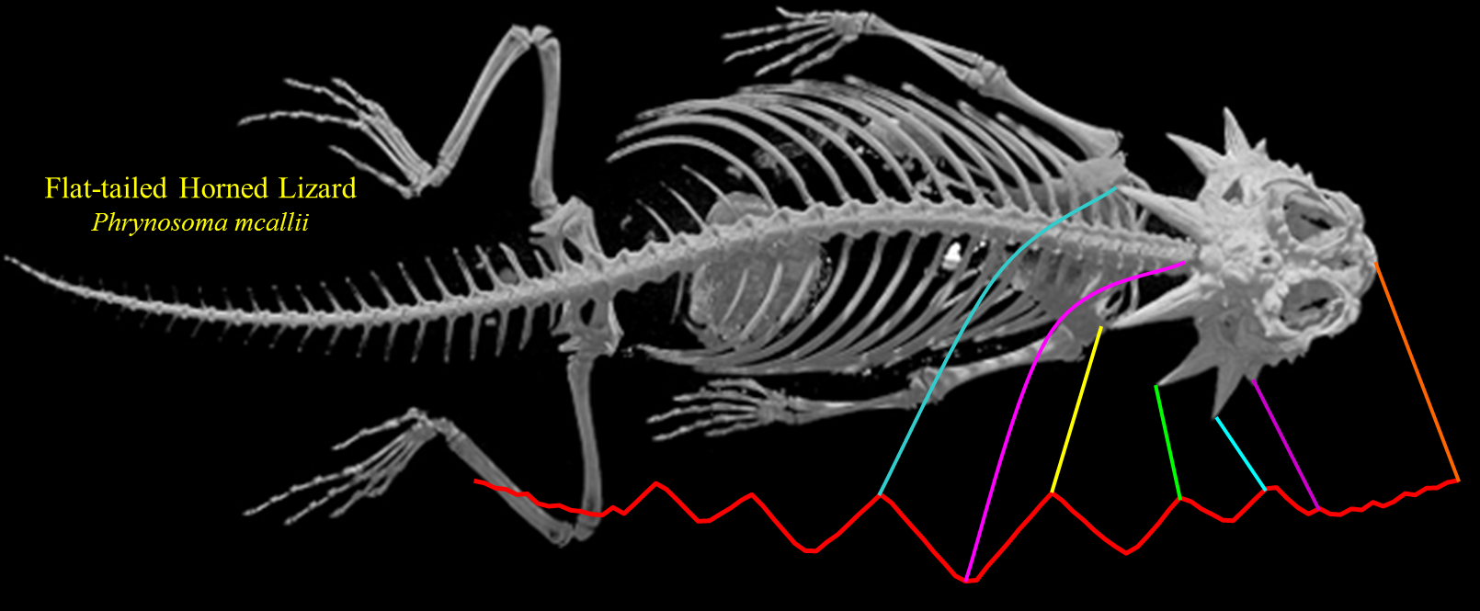


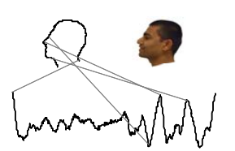
I want you to appreciate the generality of the simple code/algorithm you have seen.
You have classified industrial traces. However, many kinds of data can be represented as a time series / row of features, so the code you have can classify fish, butterfly's, faces, handwriting, gestures, golf swings, leaves, types of stars etc.
0
100
200
300
400
500
600
700
800
900
Acer circinatum
(Oregon Vine Maple)

Slide 13
Assignment
The code I gave you assumes two data files, the train and the test.
I want you to modify it, to do leave-one-out cross-validation.
To be clear, leave-one-out cross-validation does not use the TEST set, only the TRAIN set.
You can write it from scratch, or you can modify my code.
In either case, I can’t imagine this will take you more than 20 or so lines of code. If you find yourself writing more than 50 lines of code, stop! Talk to me, you have the wrong idea.
You are going to be using this code for more, graded assignments, so make sure it works correctly and is well commented.
function error_rate = leave_one_out_cross_validation
TRAIN = load('synthetic_control_TRAIN'); %
% TEST = load('synthetic_control_TEST' ); Commented out, we don’t use this for cross validation

